Slide 1
Show and Tell: A Neural Image Caption Generator
Template for Thesis Defense in Beijing Institute of Technology
School of Computer Science & Technology; BIT
Li Tong
2019.12.31

Slide 2
CONTENTS
1
Introduction
2
Method
3
Result
4
Discussion

Slide 3
1
Introduction

Slide 4
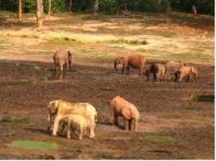

Background
A herd of elephants walk across a dry grass field
help visually impaired people better understand the content of images.

Slide 5
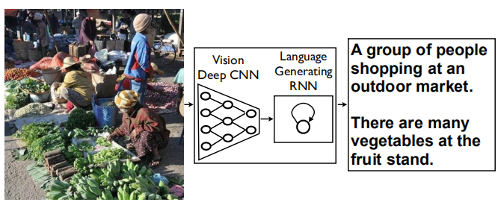
Contribution
an end-to-end system

Slide 6
2
Method

Slide 7
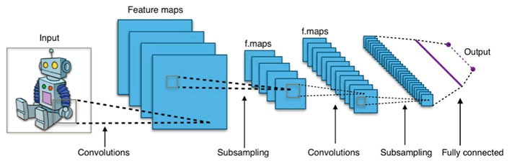
Encoder
an end-to-end syste
Image -> Feature

Slide 8
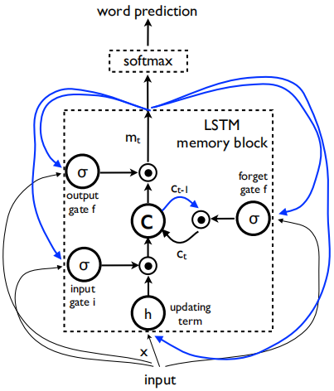
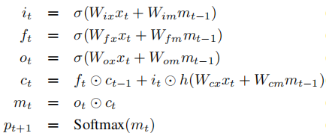
Decoder
LSTM
Formulas:
an end-to-end syste
Feature -> Sentence

Slide 9
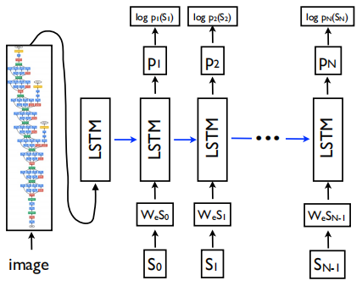
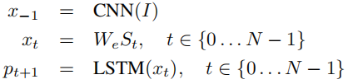
Overall Structure
Formulas:

Slide 10
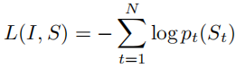
Train
Cross Entropy(交叉熵) Loss Function:
Optimization:
stochastic gradient descent(随机梯度下降)

Slide 11
3
Result

Slide 12
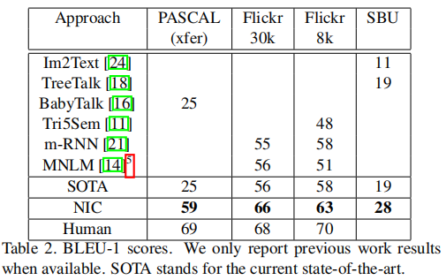
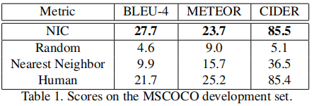
Generation Results

Slide 13
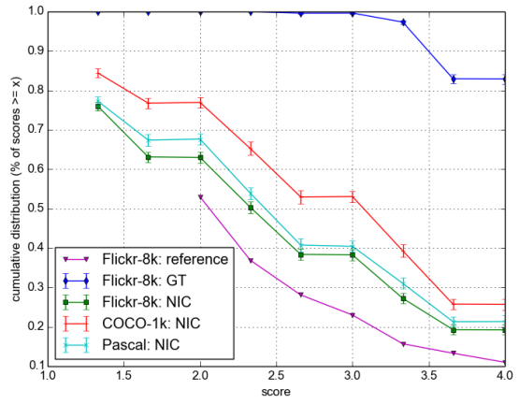
Human Evaluation Results

Slide 14
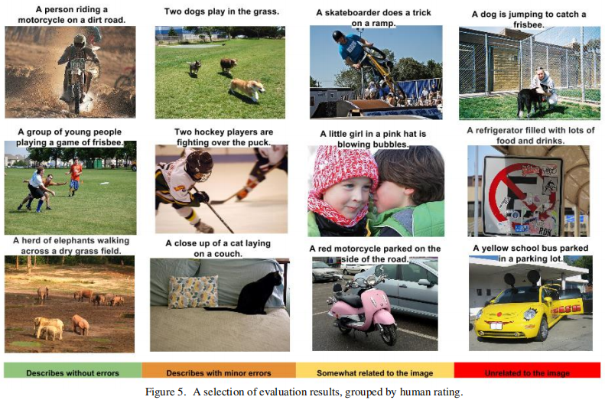
Results

Slide 15
4
Discussion

Slide 16
Discussion
This paper presented an end-to-end neural network system that can automatically view an image and generate a reasonable description.
From the results, compared with other methods, this method achieved the best performance.
In the future, we want to use unsupervised data to improve the image description approach.

Slide 17
Thanks for Your Attention

Slide 18
演讲稿
Hello everyone, I am Li Tong. I am very glad to share this paper with you on the last day of this year. This paper's title is "Show and Tell: A Neural Image Caption Generator". From this title, we can see that it is about the Image Caption task, and it uses a neural network.
Next, I will introduce the following four aspects. First, Introduction. The purpose of the Image Caption task is to let the computer understand the semantic information of the picture. Generally speaking, it is to look at a picture and return a sentence to describe the picture. As shown in the figure, input is a picture, then computer processes the picture and outputs a sentence. Of course, this task have great impacts, for example, it can help visually impaired people better understand the content of images. In previous work, some solutions divided this problem into sub-problems. For example, they first detect the objects and relationships in the picture, and then fill them into a prepared sentence template. But this paper presented a single joint model, which is based end-to-end on a neural nework consisting of a vision CNN followed by a language generating RNN. The sentences generated by this method are more abundant and natural.
Second part is Method. This model is divided into two parts: encoder and decoder.
Over the last few years it has been convincingly shown that CNNs can produce a rich representation of the input image by embedding it to a fixed-length vector, such that this representation can be used for a variety of vision tasks. Hence, it is natural to use a pre-trained CNN as an image "encoder" to extract the image feature.
For the decoder, this paper chose LSTM, which is a variant of RNN. So they use a LSTM model to translate the picture feature into a sentence. This is the structure diagram of LSTM and here are its formulas. We can see, the core of the LSTM model is a memory cell c encoding knowledge at every time step of what inputs have been observed up to this step. And this cell is controlled by three gates: input, forget and output gate. After the softmax layer, we choose the value with the highest probability in the output as the word predicted at the current time step.
This is the overall structure of this method. We use a CNN model to extract the global feature vector of the picture, and use the feature vector as the input of the first time step of LSTM. After that, LSTM takes the output of the previous time step as the input of the current time step and outputs the predicted word. In the end, we got a complete sentence describing the picture.
During the training phase, this paper used cross entropy as a loss function and used stochastic gradient descent for optimization.
Next part is the result. Table 1 shows the results of training on the MSCOCO dataset, which is the largest dataset for this task. And BLEU, CIDEr are evaluation metrics. The higher the score, the better the description generated. Table 2 shows the results of training on other datasets and comparison with other methods. The last line is the human score, which indicates the upper limit of the task. From these results it can be seen that the method of this paper got the highest score. This is the human evaluation results. We can see that NIC is better than the reference system, but clearly worse than
the ground truth, as expected. Here are some examples of results
The last part is the discussion. This paper presented an end-to-end neural network system that can automatically view an image and generate a reasonable description. And from the results, compared with other methods, this method achieved the best performance. In the future, we want to use unsupervised data to improve the image description method.

